Slide 1
January Daily Slides Infographics
Here is where your presentation begins

Slide 2
About January daily slides infographics
This template contains an assortment of complementary infographic resources for the January Daily Slides presentation.
These infographics are adapted to the style of the aforementioned presentation, so you can insert them easily and have them completely integrated at once. You just need to do the following:
Select the element that you want to copy
Right-click and choose “Copy”
Go to the slide where you want the element to appear
Right-click and choose “Paste”

Slide 3
January 2023
Mon | Tue | Wed | Thu | Fri | Sat | Sun
 |  |  |  |  |  | 1
2 | 3 | 4 | 5 | 6 | 7 | 8
9 | 10 | 11 | 12 | 13 | 14 | 15
16 | 17 | 18 | 19 | 20 | 21 | 22
23 | 24 | 25 | 26 | 27 | 28 | 29
30 | 31
01
Jupiter
Jupiter is a gas giant and the biggest planet
02
Mercury
Mercury is the closest planet to the Sun

Slide 4
January daily slides infographics
Week
Week
Week
01
03
05
Jupiter is the biggest planet
Venus has a nice name but is hot
Despite being red, Mars is cold
Week
Week
02
04
Mercury is the smallest planet
Pluto is considered a dwarf planet

Slide 5
January daily slides infographics
 | Monday | Tuesday | Wednesday | Thursday | Friday
Week 1 | Ceres is in the main asteroid |  | The Moon is a natural satellite | Venus has a beautiful name
Week 2 |  | Mars is a very cold planet |  |  | Neptune is far away from us
Week 3 | Pluto is a small dwarf planet |  | Earth is where we all live on |  | Jupiter is the biggest planet
Week 4 |  | Saturn has several rings |  | Mercury is a small planet

Slide 6
January 2023
Planner
Mercury is the closest planet to the Sun and the smallest one in the entire Solar System
Tasks
12th | Despite being red, Mars is cold
14th | Venus has a beautiful name
17th | Jupiter is the biggest planet
29th | Saturn is a gas giant with rings
January
Mon | Tue | Wed | Thu | Fri | Sat | Sun
 |  |  |  |  |  | 01
02 | 03 | 04 | 05 | 06 | 07 | 08
09 | 10 | 11 | 12 | 13 | 14 | 15
16 | 17 | 18 | 19 | 20 | 21 | 22
23 | 24 | 25 | 26 | 27 | 28 | 29
30 | 31

Slide 7
January daily slides infographics
Monthly tasks
01 | Mercury is the closest planet to the Sun and the smallest one in the entire Solar System | January 1st
02 | Venus has a very beautiful name but is actually terribly hot, hotter than Mercury | January 8th
03 | Saturn is a gas giant and has several rings. It's composed mostly of hydrogen and helium | January 12th
04 | Earth is the third planet from the Sun and the only one that harbors life in the Solar System | January 21st

Slide 8
January daily slides infographics
Week 1
Week 2
Week 3
Week 4
Week 5
Task 1
Neptune is the fourth-largest planet
Task 2
Saturn is a gas giant composed of hydrogen and helium
Task 3
Jupiter is the biggest planet
Task 4
Despite being red, Mars is actually a cold place

Slide 9
January 2023
January
Mon | Tue | Wed | Thu | Fri | Sat | Sun
 |  |  |  |  |  | 01
02 | 03 | 04 | 05 | 06 | 07 | 08
09 | 10 | 11 | 12 | 13 | 14 | 15
16 | 17 | 18 | 19 | 20 | 21 | 22
23 | 24 | 25 | 26 | 27 | 28 | 29
30 | 31
Notes
Mercury is the closest planet to the Sun and the smallest one of all the planets in the Solar System. This planet's name has nothing to do with the liquid metal, since Mercury was named after the Roman messenger god

Slide 10
January daily slides infographics
Today goals
Jupiter is a gas giant and the biggest planet The Moon is a natural satellite of Earth Venus has a beautiful name but is very hot
Task list
Neptune is the farthest planet from the Sun Despite being red, Mars is a cold place Saturn is a gas giant and has several rings
Urgent
Pluto is considered a dwarf planet Earth is the third planet from the Sun Ceres is located in the main asteroid belt
Notes | Mercury is the closest planet to the Sun and the smallest one of all the planets in the Solar System. This planet's name has nothing to do with the liquid metal, since Mercury was named after the Roman messenger god

Slide 11
January 2023
Mon | Tue | Wed | Thu | Fri | Sat | Sun
 |  |  |  |  |  | 1
2 | 3 | 4 | 5 | 6 | 7 | 8
9 | 10 | 11 | 12 | 13 | 14 | 15
16 | 17 | 18 | 19 | 20 | 21 | 22
23 | 24 | 25 | 26 | 27 | 28 | 29
30 | 31
Start
Finish
Jupiter is a gas giant and the biggest planet
Mercury is the closest planet to the Sun

Slide 12
January daily slides infographics
 | Schedule | Notes
08:00 | Jupiter is a gas giant | It’s the biggest planet
09:00 | Mars is red | It’s a cold place
10:00 | Venus is a hot planet | It has a beautiful name
11:00 | Earth is the third one | It harbors life
12:00 | Neptune is a gas giant | It’s far from the Sun
13:00 | Pluto is a dwarf planet | Ceres is in the main asteroid
Daily schedule
20
Friday
Saturn is mostly composed of hydrogen and helium

Slide 13
January daily slides infographics
 |  | Schedule | Notes
08:00 | Meeting | Jupiter is a gas giant | It’s the biggest planet
09:00 | Videocall | Mars is red | It’s a cold place
10:00 | Interview | Venus is a hot planet | It has a beautiful name
11:00 | Meeting | Earth is the third one | It harbors life
12:00 | Meeting | Neptune is a gas giant | It’s far from the Sun
Most important
Important
Relevant
Not so important

Slide 14
January daily slides infographics
9:00-10:00 |  | 10:00-11:00 |  | 11:00-12:00 |  | 12:00-13:00
Jupiter is a gas giant and the biggest planet |  | Mercury is the closest planet to the Sun |  | Venus has a beautiful name but is hot |  | Earth is the only planet that harbors life
 | Answer immediately |  | Update ongoing assignments |  | Show work constraints |  | Answer immediately
 | Assign team members |  | Answer immediately |  | Update ongoing assignments |  | Show work constraints
 | Show work constraints |  | Assign team members |  | Answer immediately |  | Update ongoing assignments

Slide 15
January 2023
January
Mon | Tue | Wed | Thu | Fri | Sat | Sun
 |  |  |  |  |  | 01
02 | 03 | 04 | 05 | 06 | 07 | 08
09 | 10 | 11 | 12 | 13 | 14 | 15
16 | 17 | 18 | 19 | 20 | 21 | 22
23 | 24 | 25 | 26 | 27 | 28 | 29
30 | 31
Neptune
Neptune is the farthest planet from the Sun
Mercury
Mercury is the closest planet to the Sun

Slide 16
January daily slides infographics
01 | Jupiter is a gas giant
02 | Venus is a hot planet
03 | Ceres is in the main asteroid
Monday
January 2nd
01 | Neptune is a gas giant
02 | Earth is the planet that harbors life
03 | Pluto is a dwarf planet
Tuesday
January 3rd

Slide 17
January daily slides infographics
Phase 4
Phase 3
Live
Lunch
14:00-16:00
Phase 2
Contacts
12:00-14:00
Phase 1
Info
10:00-12:00
8:00-10:00

Slide 18
January 2023
Mon | Tue | Wed | Thu | Fri | Sat | Sun
 |  |  |  |  |  | 1
2 | 3 | 4 | 5 | 6 | 7 | 8
9 | 10 | 11 | 12 | 13 | 14 | 15
16 | 17 | 18 | 19 | 20 | 21 | 22
23/30 | 24/31 | 25 | 26 | 27 | 28 | 29
Mercury
Mars
Jupiter
Neptune
Mercury is the closest planet to the Sun
Despite being red, Mars is a cold place
Jupiter is a gas giant and the biggest planet
Neptune is very far away from the Sun

Slide 19
January daily slides infographics
January 2023 | Mon | Tue | Wed | Thu | Fri | Sat | Sun
Goals | 4 | 5 | 6 | 7 | 8 | 9 | 10
Mercury is the closest planet to the Sun and the smallest one of them all
Despite being red, Mars is actually a very cold planet
Venus has a beautiful name but is a really hot place

Slide 20
January daily slides infographics
Goal 01
Priorities
Jupiter is the biggest planet
Mercury is the closest planet to the Sun and the smallest one of all the planets in the Solar System. This planet's name has nothing to do with the liquid metal
Goal 02
Mercury is the smallest planet
Notes
Venus has a beautiful name and is the second planet from the Sun. It’s terribly hot, even hotter than Mercury, and its atmosphere is extremely poisonous
Goal 03
Venus has a nice name

Slide 21
January daily slides infographics
Day 4 | Schedule
08:00 | Jupiter is a gas giant
09:00 | Mars is red
10:00 | Venus has a beautiful name
11:00 | Earth is the third one
12:00 | Neptune is a gas giant
13:00 | Pluto is a dwarf planet
14:00 | Saturn is the ringed one
Week 1
01 | 02 | 03 | 04 | 05 | 06 | 07
Task 1
Task 2
Task 3
Task 4
Mercury is the smallest planet of them all
Venus has a beautiful name but is hot
Despite being red, Mars is a cold place
Jupiter is the biggest planet of them all

Slide 22
January daily slides infographics
Monday morning | 08:00 | 09:00 | 10:00 | 11:00 | 12:00
Marketing | Earth is the third planet from the Sun and harbors life
Financial |  | Venus has a beautiful name but is a hot planet
Design |  | Mercury is the closest planet to the Sun and the smallest one
Legal |  |  | Despite being red, Mars is actually a very cold place

Slide 23
January daily slides infographics
07:00 | 08:00 | 09:00 | 10:00
Jupiter is a gas giant and the biggest planet | Mercury is the closest planet to the Sun | Venus has a beautiful name but is hot | Earth is the third planet from the Sun
11:00 | 12:00 | 13:00 | 14:00
Neptune is the farthest planet from the Sun | Despite being red, Mars is a cold place | Pluto is considered a dwarf planet | Ceres is located in the main asteroid belt
15:00 | 16:00 | 17:00 | 18:00
Venus is actually terribly hot, hotter than Mercury | Mercury is the smallest planet of them all | Saturn is composed mostly of hydrogen | Earth is the planet that harbors life

Slide 24
January daily slides infographics
Thursday
12 | January
08:00 | Venus has a beautiful name
09:00 | Despite being red, Mars is cold
10:00 | Jupiter is the biggest one
11:00 | Earth is the third one from the Sun
12:00 | Mercury is the smallest planet
Friday
13 | January
08:00 | Pluto is considered a dwarf planet
09:00 | Ceres is located in the main asteroid
10:00 | Neptune is a gas giant
11:00 | Saturn is a gas giant with rings
12:00 | The Moon is our natural satellite

Slide 25
January daily slides infographics
Step 1
Step 3
09:00
12:00
Jupiter is a gas giant and it’s very big
Venus has a nice name but is hot
Step 2
Step 4
11:00
15:00
Mercury is very close to the Sun
Pluto is considered a dwarf planet

Slide 26
January daily slides infographics
January
Progress | Tasks
50% | Mercury is the closest planet to the Sun
35% | Mars is a cold place full of iron oxide dust
30% | Saturn is a gas giant and has several rings
Day
01 | 02 | 03 | 04 | 05 | 06 | 07

Slide 27
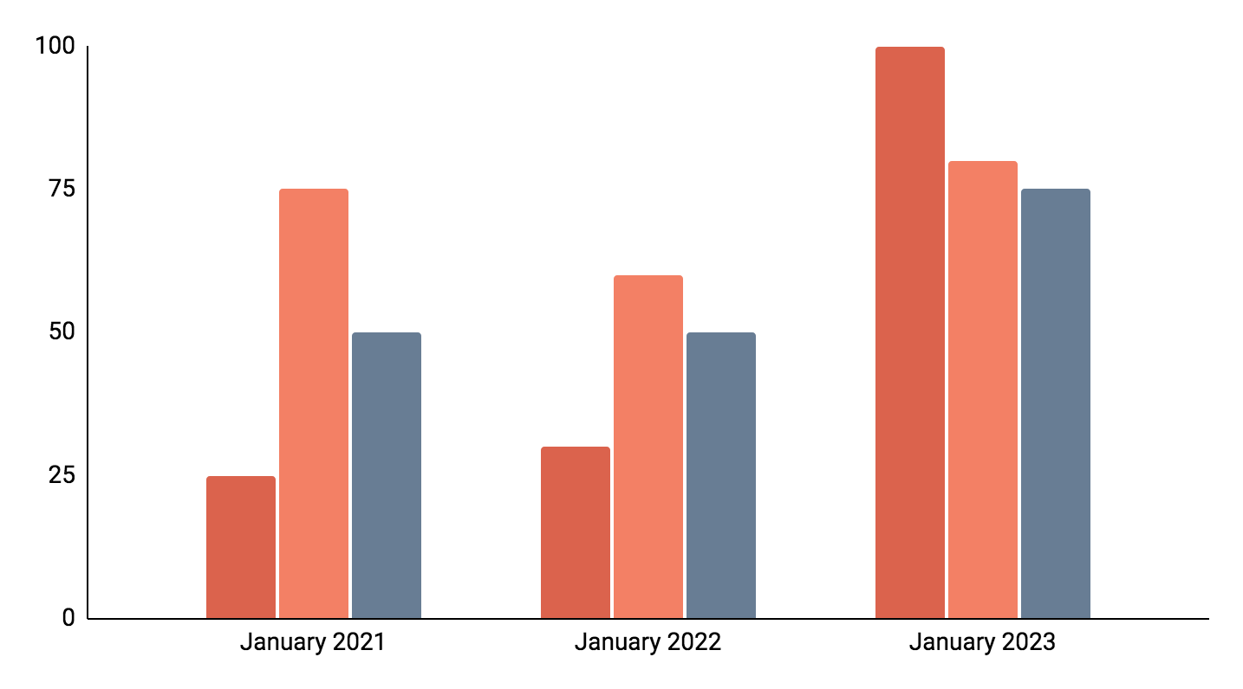
January daily slides infographics
Income
Neptune is the farthest planet from the Sun
Budget
Venus has a beautiful name but is hot
Costs
Mercury is the closest planet to the Sun
Follow the link in the graph to modify its data and then paste the new one here. For more info, click here

Slide 28
January 2023
11:00
Task 1
January
Mon | Tue | Wed | Thu | Fri | Sat | Sun
 |  |  |  |  |  | 01
02 | 03 | 04 | 05 | 06 | 07 | 08
09 | 10 | 11 | 12 | 13 | 14 | 15
16 | 17 | 18 | 19 | 20 | 21 | 22
23 | 24 | 25 | 26 | 27 | 28 | 29
30 | 31
Neptune is the farthest planet from the Sun
14:00
Task 2
Venus has a beautiful name but is hot
15:00
Task 3
Mercury is the closest planet to the Sun

Slide 29
January daily slides infographics
Week 1
Week 2
Week 3
Week 4
Week 5
Week 6
Action 1
Neptune is the farthest planet to the Sun
Action 2
Saturn is a gas giant composed of hydrogen and helium
Action 3
Jupiter is a gas giant and also the biggest planet
Action 4
Despite being red, Mars is actually a cold place
Action 5
Venus has a nice name, but it’s terribly hot

Slide 30
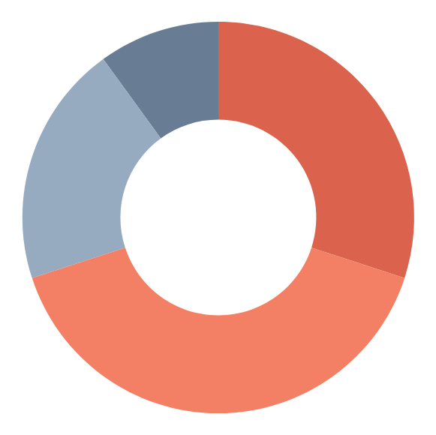
January daily slides infographics
30%
40%
Study
Work
Jupiter is a gas giant and it’s very big
Venus has a nice name but is hot
20%
10%
Leisure
Sport
Mercury is the closest to the Sun
Pluto is considered a dwarf planet
Follow the link in the graph to modify its data and then paste the new one here. For more info, click here

Slide 31
January daily slides infographics
January project
Milestone 1
01
Neptune is the farthest planet from the Sun
Mercury is the closest planet to the Sun and the smallest one of all the planets in the Solar System
02
Milestone 2
Despite being red, Mars is a cold place
Project director
John Doe
Milestone 3
03
Project manager
Pluto is considered a dwarf planet
Helena James

Slide 32
January 2023
Mon | Tue | Wed | Thu | Fri | Sat | Sun
 |  |  |  |  |  | 01
02 | 03 | 04 | 05 | 06 | 07 | 08
09 | 10 | 11 | 12 | 13 | 14 | 15
16 | 17 | 18 | 19 | 20 | 21 | 22
23 | 24 | 25 | 26 | 27 | 28 | 29
30 | 31
Task 1
Task 2
Jupiter is a gas giant and the biggest planet
Neptune is the farthest planet from the Sun
Task 3
Task 4
Mercury is the closest planet to the Sun
Despite being red, Mars is a cold place

Slide 33
Instructions for use
If you have a free account, in order to use this template, you must credit Slidesgo in your final presentation. Please refer to the next slide to read the instructions for premium users.
As a Free user, you are allowed to:
- Modify this template.
- Use it for both personal and commercial projects.
You are not allowed to:
- Sublicense, sell or rent any of Slidesgo Content (or a modified version of Slidesgo Content).
- Distribute Slidesgo Content unless it has been expressly authorized by Slidesgo.
- Include Slidesgo Content in an online or offline database or file.
- Offer Slidesgo templates (or modified versions of Slidesgo templates) for download.
- Acquire the copyright of Slidesgo Content.
For more information about editing slides, please read our FAQs or visit Slidesgo School:
https://slidesgo.com/faqs and https://slidesgo.com/slidesgo-school

Slide 34
Instructions for use (premium users)
As a Premium user, you can use this template without attributing Slidesgo.
You are allowed to:
Modify this template.
Use it for both personal and commercial purposes.
Hide or delete the “Thanks” slide and the mention to Slidesgo in the credits.
Share this template in an editable format with people who are not part of your team.
You are not allowed to:
Sublicense, sell or rent this Slidesgo Template (or a modified version of this Slidesgo Template).
Distribute this Slidesgo Template (or a modified version of this Slidesgo Template) or include it in a database or in any other product or service that offers downloadable images, icons or presentations that may be subject to distribution or resale.
Use any of the elements that are part of this Slidesgo Template in an isolated and separated way from this Template.
Register any of the elements that are part of this template as a trademark or logo, or register it as a work in an intellectual property registry or similar.
For more information about editing slides, please read our FAQs or visit Slidesgo School:
https://slidesgo.com/faqs and https://slidesgo.com/slidesgo-school

Slide 35
Infographics
You can add and edit some infographics to your presentation to present your data in a visual way.
Choose your favourite infographic and insert it in your presentation using Ctrl C + Ctrl V or Cmd C + Cmd V in Mac.
Select one of the parts and ungroup it by right-clicking and choosing “Ungroup”.
Change the color by clicking on the paint bucket.
Then resize the element by clicking and dragging one of the square-shaped points of its bounding box (the cursor should look like a double-headed arrow). Remember to hold Shift while dragging to keep the proportions.
Group the elements again by selecting them, right-clicking and choosing “Group”.
Repeat the steps above with the other parts and when you’re done editing, copy the end result and paste it into your presentation.
Remember to choose the “Keep source formatting” option so that it keeps the design. For more info, please visit Slidesgo School.

